Slide 1


“Emergency remote teaching”, digital disruption and a new (ab)normal: reflections on the impacts of COVID-19 on UK universities
Professor Tom Crick
Professor of Digital Education & Policy,
Swansea University, UK
@ProFTOMCRICK
@EDUCATIONSU
#AEL2021

Slide 2

Drawing on data from 3 major empirical studies over the last 12 months, consulting +7000 UK HE workers

Slide 3





UK HE academic staff:
Immediate perspectives on transitioning to remote working

Slide 4
OVERVIEW
Online attitudinal survey of educators (worldwide/across sectors), generating almost N=3000 responses
Distributed through professional networks
N=1,148 responses academics working in UK universities: England n=907; Wales n=110; Scotland n=104; Northern Ireland N=25
Respondents representing all disciplinary fields & career hierarchy
Gender split: 58% female, 39% male, 1% prefer to self-describe, 2% prefer not to say
Employment status:
  79% Full-Time
  83% Open-Ended Contracts

Slide 5
Respondent Profiles

Slide 6
Headline findings

Slide 9
Themes from open text responses
Destabilisation of student marketplace in the UK:
  issues of recruitment and retention; threat from private HE providers and edtech sector;
Economic impact not only in terms of decreased revenue from tuition fees but other university services and by extension to local economies/national GDP;
Deprofessionalisation, dumbing-down;
Precarisation, jobs obsolescence, job cuts;
Work intensification, gender inequality;
Cessation of research:
  impact on academic labour market (e.g. ECRs)
Limited identification with digital affordances and digital practice.

Slide 10

HE academic staff: impact on welfare, health and wellbeing

Slide 11
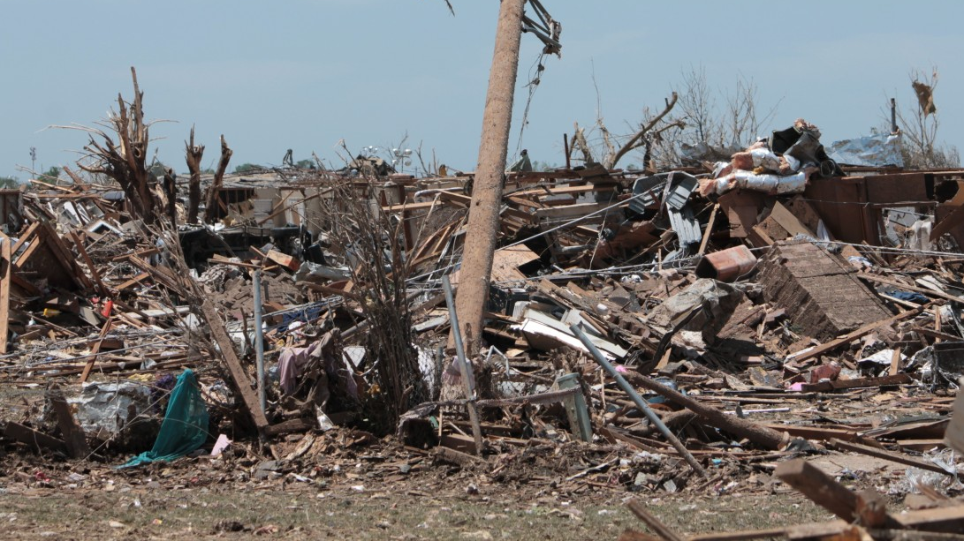
“Pandemia”
Overview
International survey of N=2649 academics; n=1099 UK (65% female; 61% open-ended contracts; 66% from ”research intensive” universities
Key Themes
Crisis-management = creep of undemocratic forms of institutional governance; cost-cutting (disaster management); deprioritisation of research;
Impaired trust in university leadership;
Increase in labour casualisation; job insecurity;
Rise in work exploitation and work-based inequalities;
Headline Statistics
84%: corporate response of universities has contributed to work related stress
85%: suffering from digital fatigue
77%: feeling demotivated
81%: major damage to the job prospects of ECRs
92%: changes to academics’ working lives as a consequence of institutional responses to COVID-19 have resulted in long-lasting impacts to health and wellbeing

Slide 12

HE professional service staff:
Work experiences under COVID-19

Slide 13
Sample
Number of completed surveys: N=4801
Gender
Male 28%
Female 71%
Prefer to self-describe 1%
Employment status
Part-time 22%
Full-time 78%
Type of institution
Pre-1992 64%
Post-1992 28%
Not sure 8%

Slide 14

Impact on work ability and work productivity

Slide 15
Impact on mental and physical health and wellbeing

Slide 16
64% of respondents rate their university’s senior leadership through the pandemic as: COMPETENT

Slide 17
A longer-term move away from campuses?

Slide 18
Looking ahead…
The COVID-19 context has clearly not gone away, but has shifted — a new (ab) normal?;
Challenges/opportunities presented from “emergency remote teaching” and rapid shift to online LT&A;
Impact across different settings, disciplines and domains;
Renewed focus on digital pedagogy and practice (faculty, students, society?);
Investment in professional development?
More criticality needed on widespread application of edtech;
Wider policy context: post-COVID economic recovery, increased focus on “digital”, future skills demands.

Slide 19
Thank you/diolch yn fawr!
Watermeyer, R., Shankar, K., Crick, T., Knight, C., McGaughey, F., Hardman, J., Suri, V.R., Chung, R. and Phelan, D. (2021). ‘Pandemia’: A reckoning of UK universities’ corporate response to COVID-19 and its academic fallout. British Journal of Sociology of Education (forthcoming)
Crick, T., Knight, C., Watermeyer, R., & Goodall, J. (2021). The International Impact of COVID-19 and “Emergency Remote Teaching” on Computer Science Education Practitioners. Proceedings of IEEE Global Engineering Education Conference (EDUCON’21). IEEE Press, 2021, https://cronfa.swan.ac.uk/Record/cronfa56273
Crick, T. (2021). COVID-19 and Digital Education: A Catalyst for Change?. ITNOW, 63(1) https://doi.org/10.1093/itnow/bwab005
Watermeyer, R., Crick, T., Knight, C., & Goodall, J. (2020). COVID-19 and digital disruption in UK universities: afflictions and affordances of emergency online migration. Higher Education, 81, 623-641 https://doi.org/10.1007/s10734-020-00561-y
Watermeyer, R., Crick, T., Knight, C., & Goodall, J. (2020).
forced shift to online teaching in coronavirus pandemic unleashes educators’ deepest job fears. Nature Index. Available from: https://www.natureindex.com/news-blog/forced-shift-to-online-teaching-in-coronavirus-pandemic-unleashes-educators-deepest-job-fears-
Watermeyer, R., Crick, T., Knight, C., & Goodall, J. (2020). Academic lives are in transition. Wonkhe. Available from: https://wonkhe.com/blogs/academic-lives-are-in-transition/
We would like to acknowledge the contribution of our wider team of researchers including:
Professor Richard Watermeyer (University of Bristol, UK); Dr Cathryn Knight and Dr Janet Goodall (Swansea University); Professor Kalpana Shankar (UCD, Ireland); Dr Fiona McGaughey (University of Western Australia); Dr Joanna Hardman (University of Cape Town, SA); Dr Venkata Ratnadeep Suri (Indraprastha Institute of Information Technology, India); Dr Roger Chung (Chinese University of Hong Kong); Dr Dean Phelan (Maynooth University, Ireland) and Margarida Borras Batalla (University of Bristol) in addition to funding provided by the Worldwide Universities Network (WUN)
CONTACT thomas.crick@swansea.ac.uk
https://proftomcrick.com
#AEL2021

