Slide 1

Policy Options & Consequences:
“Education System Design —
Perspectives from Across the UK”
Professor Tom Crick
(@ProfTomCrick)
11 May 2021
#BERAEdPolicy

Slide 2
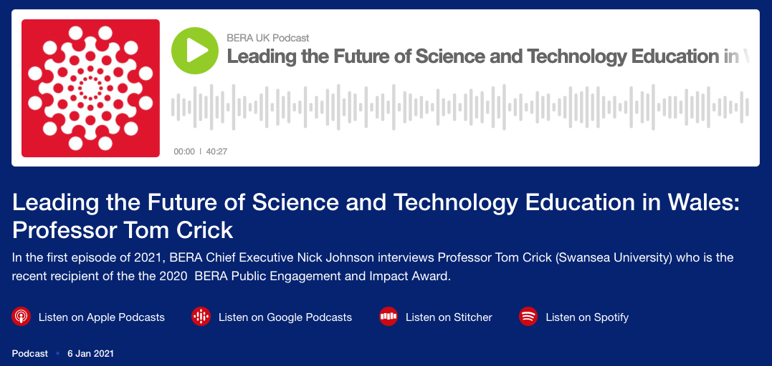
Listen: BERA Public Engagement and Impact Award 2020
11 May 2021
#BERAEdPolicy

Slide 3
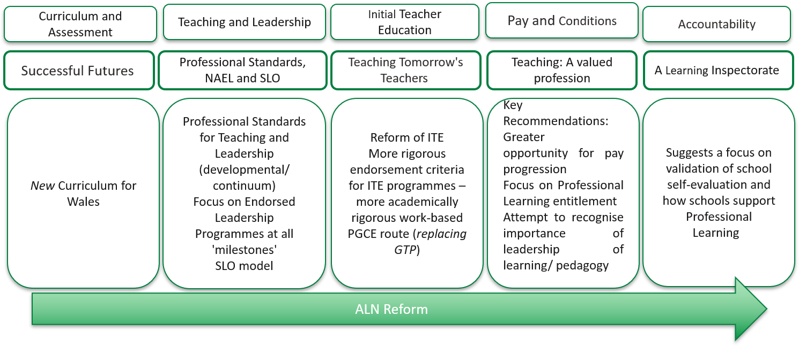
System-Level Reform in Wales
11 May 2021
#BERAEdPolicy

Slide 4
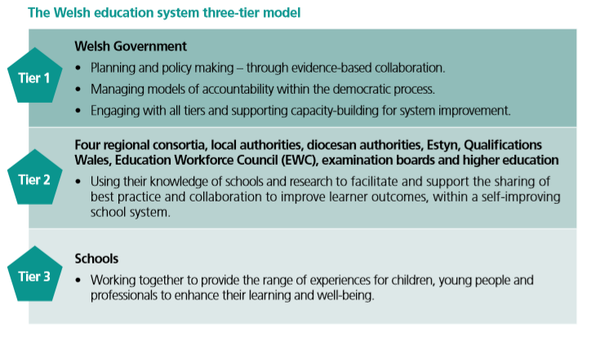
Policy Context in Wales
11 May 2021
#BERAEdPolicy

Slide 5
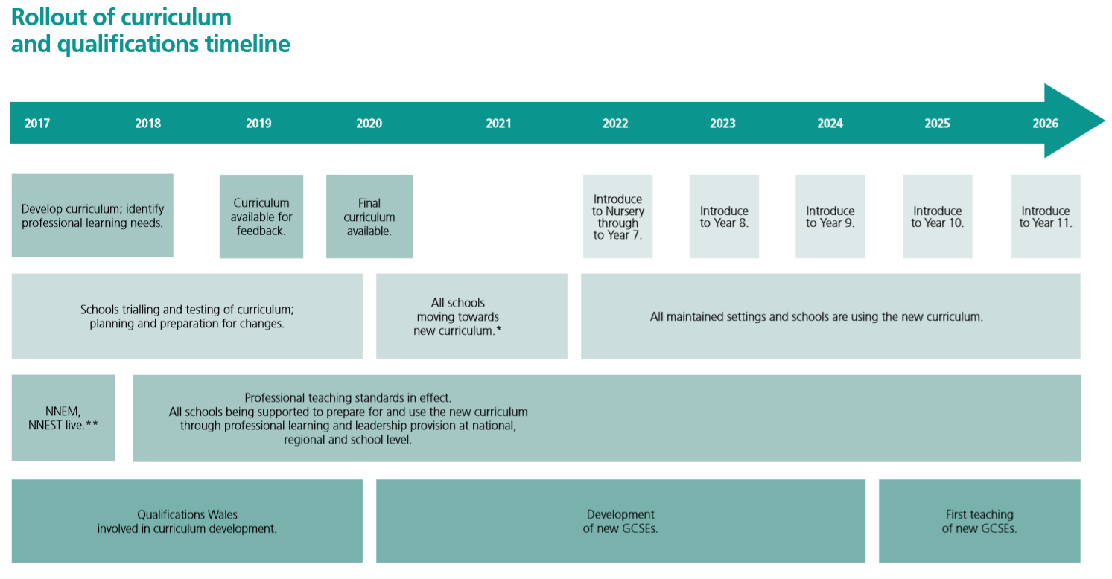
“A National Mission” (2015-present)

Slide 6


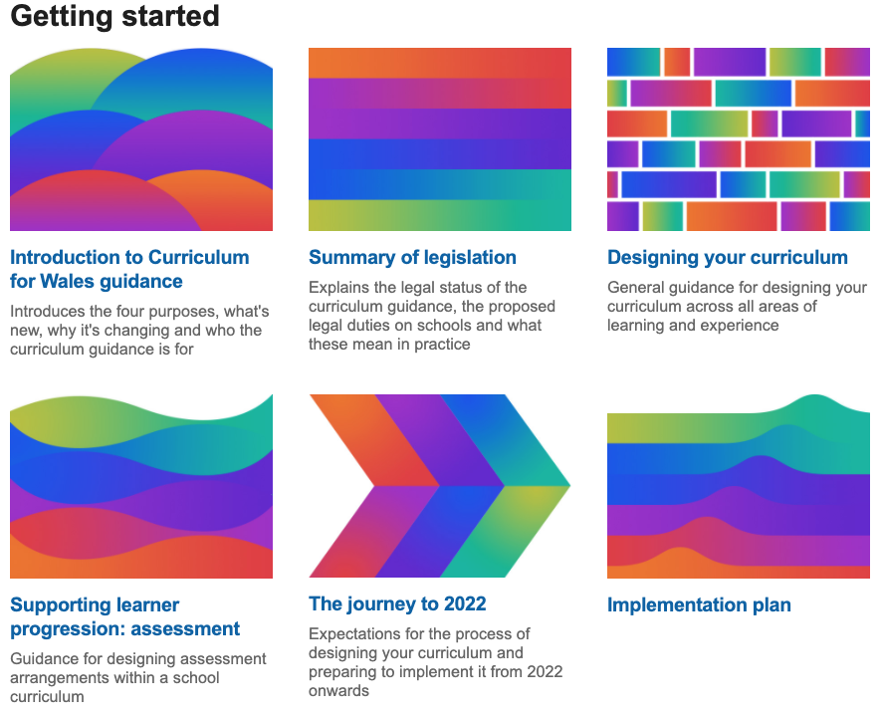

Curriculum for Wales 2022

Slide 7
Societal, Cultural and Economic Impact
Recognising imperatives of curriculum, qualifications and wider system-level reform in Wales: “Our National Mission”;
The long haul: 2011-present! (3 now: 4 x Ministers);
Political and policy challenges: Wales, UK and internationally;
Building the educational research base in Wales;
Bridging research, policy and practice;
Practitioner agency, confidence and capability;
Social/cultural/heritage levers e.g. Welsh language and history;
Future generations: addressing inequity/inequality in society;
Wider policy: future citizens and economy of Wales?
Longer-term impact of COVID-19 on education;
…and a new Welsh Government from May 2021!
11 May 2021
#BERAEdPolicy

Slide 8
Diolch yn fawr/thank you!
Professor Tom Crick MBE
School of Social Sciences
Swansea University
https://proftomcrick.com
11 May 2021
#BERAEdPolicy

