Slide 1

Impacts of COVID-19 on UK higher education staff
Tom Crick MBE
Professor of Digital
Education & Policy,
Swansea University
@ProFTOMCRICK
@EDUCATIONSU
Richard Watermeyer
Professor of Higher Education,
University of Bristol &
CO-DiRector of the Centre for Higher Education Transformations (CHET)
@rpwatermeyer
@chet_for
#QAA2021

Slide 2

Drawing on data from 3 major empirical studies over the last 12 months, consulting +7000 UK HE workers

Slide 3





Academic staff:
Immediate perspectives on transitioning to remote working

Slide 4
OVERVIEW
Online attitudinal survey of educators (worldwide/across sectors), generating almost N=3000 responses
Distributed through professional networks
N=1,148 responses academics working in UK universities: England n=907; Wales n=110; Scotland n=104; Northern Ireland N=25
Respondents representing all disciplinary fields & career hierarchy
Gender split: 58% female, 39% male, 1% prefer to self-describe, 2% prefer not to say
Employment status:
  79% Full-Time
  83% Open-Ended Contracts

Slide 5
Respondent Profiles

Slide 6
Headline findings

Slide 9
Themes from open-text responses
destabilisation of student marketplace
  issues of recruitment and retention; threat from private HE providers and edtech sector
economic impact not only in terms of decreased revenue from tuition fees but other university services and by extension to local economies/national GDP
deprofessionalisation, dumbing-down
precarization, jobs obsolescence, job cuts
work intensification, gender inequality
cessation of research
  impact on academic labour market
limited identification with digital affordances

Slide 10

Academic staff: impact on welfare, health and wellbeing

Slide 11
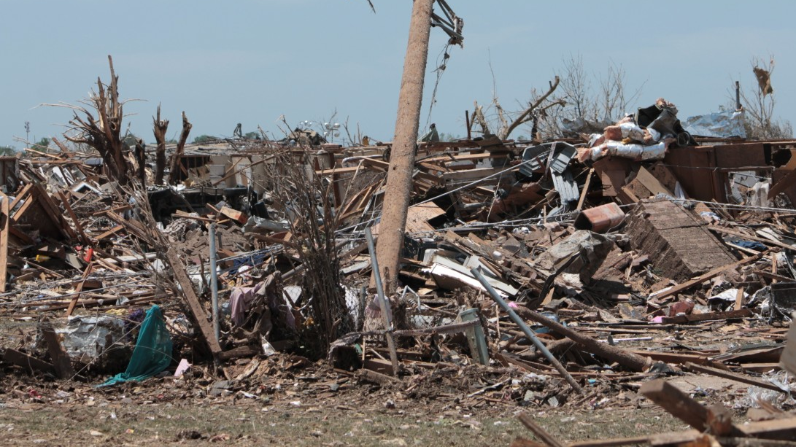
“Pandemia”
Overview
International survey of n=2649 academics; n=1099 UK (65% female; 61% open-ended contracts; 66% from ”research intensive” universities
Key themes
Crisis-management = creep of undemocratic forms of institutional governance; cost-cutting (disaster management); deprioritisation of research
Impaired trust in university leadership
Increase in labour casualization; job insecurity
Rise in work exploitation and work-based inequalities
Key stats
84%: corporate response of universities has contributed to work related stress
85%: suffering from digital fatigue
77%: feeling demotivated
81%: major damage to the job prospects of ECRs
92%: changes to academics’ working lives as a consequence of institutional responses to COVID-19 have resulted in long-lasting impacts to health and wellbeing

Slide 12

Professional service staff: work experiences under COVID-19

Slide 13
Sample
Number of completed surveys: n=4801
Gender
Male 28%
Female 71%
Prefer to self-describe 1%
Employment status
Part-time 22%
Full-time 78%
Type of institution
Pre-1992 64%
Post-1992 28%
Not sure 8%

Slide 14

Impact on work ability and work productivity

Slide 15
Impact on mental and physical health and wellbeing

Slide 16
64% of respondents rate their university’s senior leadership through the pandemic as: COMPETENT

Slide 17
A move away from campuses?

Slide 18
Thank you/diolch yn fawr!
Watermeyer, R., Shankar, K., Crick, T., Knight, C., McGaughey, F., Hardman, J., Suri, V.R., Chung, R. and Phelan, D. (2021) ‘Pandemia’: A reckoning of UK universities’ corporate response to COVID-19 and its academic fallout. British Journal of Sociology of Education (forthcoming)
Watermeyer, R., Crick, T., Knight, C., and Goodall, J. (2020) COVID-19 and digital disruption in uk universities: afflictions and affordances of emergency online migration. Higher Education, 81, 623-641 https://doi.org/10.1007/s10734-020-00561-y
Watermeyer, R., Crick, T., Knight, C., and Goodall, J. (2020)
forced shift to online teaching in coronavirus pandemic unleashes educators’ deepest job fears. Nature Index. available from: https://www.natureindex.com/news-blog/forced-shift-to-online-teaching-in-coronavirus-pandemic-unleashes-educators-deepest-job-fears-
Watermeyer, R., Crick, T., Knight, C., and Goodall, J. (2020) academic lives are in transition. Wonkhe. Available from: https://wonkhe.com/blogs/academic-lives-are-in-transition/
We would like to acknowledge the contribution of our wider team of researchers including:
Dr Cathryn Knight and Dr Janet Goodall (Swansea University); Professor Kalpana Shankar (UCD); Dr Fiona McGaughey (University of Western Australia); Dr Joanna Hardman (University of Cape Town); Dr Venkata Ratnadeep Suri (Indraprastha Institute of Information Technology); Dr Roger Chung (Chinese University of Hong Kong); Dr Dean Phelan (Maynooth University) and Margarida Borras Batalla (University of Bristol) in addition to funding provided by the Worldwide Universities Network (WUN)
CONTACT thomas.crick@swansea.ac.uk
richard.watermeyer@bristol.ac.uk
#QAA2021

